Slide 1
CNN Accelerator
Configuration/Optimization
AIHA-Intern-2023-NPU
Dongbeom Son / Wonbin Seo / Sumin Lee
bumin35@hanyang.ac.kr / kkyou123@hanyang.ac.kr / slbiog3025@hanyang.ac.kr
2023 aiha-intern

Slide 2
Table of Contents
Cycle Analysis
Baseline Cycle Analysis
Optimize Configuration
VGG-16 Structure
Configuring PE-Arrays for VGG-16
Configuring PE-ROW for Memory Bottleneck
Utilization Unused PE Element
Optimal Configuration
Testing for Other Network (Resnet-50)
Retest VGG16 Using ResNet50 Configuration
Change Kernel Clock Frequency
Configuration table
  300MHz
  500MHz
  Configuration Table Using Same Memory Bank (300MHz)
  Configuration Table Using Same Memory Bank (500MHz)
  Configuration Table Issue resolved (300MHz)
  Configuration Table Issue resolved (500MHz)

Slide 3

Cycle Analysis
Theoretical cycle = $cyc_{th}=\left(t+k−1\right)×T_{r}×T_{c}×c_{i}×c_{o}$
Practical cycle = $cyc_{pr}=cyc_{th}$+ write 0 overhead + initialize psum buffer + final write back
= $cyc_{th}+T_{r}×T_{c}×c_{i}×c_{o}+\left(t+k−1\right)+t×act+so$
($act$ = # of write_port_activation, $so$ = state transition overhead)
= $cyc_{th}+T_{r}×T_{c}×c_{i}×c_{o}+\left(t+k−1\right)+t ×3 + 6$
Required multiplication : $OPs=o_{w}×o_{h}×k^{2}×c_{i}×c_{o}$
# of multiplier = n = # of PE element $× 3 =$ $3 ×k ×r$
Ideal cycle = $cyc_{ideal}$= $\frac{OPs}{n}$
  Tile_length = $t$
  Kernel_size = $k$
  PE_array row = $r$
  Tile_column = $T_{c}$ = $⌈\frac{i_{w}}{t}⌉$
  Tile_row = $T_{r}$ = $\left\lceil \frac{o_{h}}{r}\right\rceil$
  input channel = $c_{i}$
  output channel = $c_{o}$

Slide 4

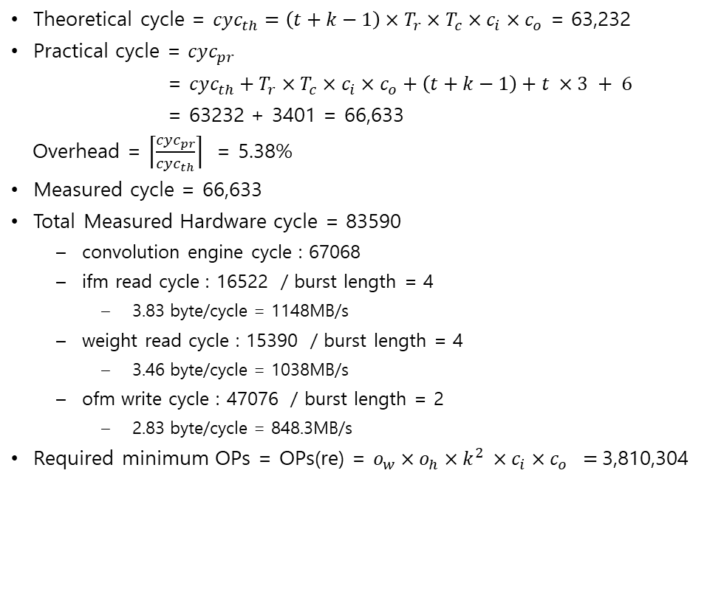
Baseline Cycle Analysis
Theoretical cycle = $cyc_{th}=\left(t+k−1\right)×T_{r}×T_{c}×c_{i}×c_{o}$ = 63,232
Practical cycle = $cyc_{pr}$
= $cyc_{th}+T_{r}×T_{c}×c_{i}×c_{o}+\left(t+k−1\right)+t ×3 + 6$
= 63232 + 3401 = 66,633
Overhead = $\left\lceil \frac{cyc_{pr}}{cyc_{th}}\right\rceil$ = 5.38%
Measured cycle = 66,633
Total Measured Hardware cycle = 83590
  convolution engine cycle : 67068
  ifm read cycle : 16522 / burst length = 4
    3.83 byte/cycle = 1148MB/s
  weight read cycle : 15390 / burst length = 4
    3.46 byte/cycle = 1038MB/s
  ofm write cycle : 47076 / burst length = 2
    2.83 byte/cycle = 848.3MB/s
Required minimum OPs = OPs(re) = $o_{w}×o_{h}×k^{2} ×c_{i}×c_{o} =$3,810,304
# of multiplier = n # of PE element $×$ $3$ = $3 ×k ×r$= 80
Ideal cycle = cyc(id) = $\frac{OPs_{re}}{n}$= 47,629 , Overhead = $\frac{cyc_{pr}}{cyc_{id}}$= 39.9%
  Tile_length = $t = 16$
  Kernel_size = $k = 4$
  PE_array row $= r = 5$
  Tile_column = $T_{c}$= $⌈\frac{i_{w}}{t}⌉ = 4$
  Tile_row = $T_{r}$= $⌈\frac{o_{h}}{r}⌉= 13$
  input channel = $c_{i} = 8$
  output channel =$c_{o} = 8$

Slide 5
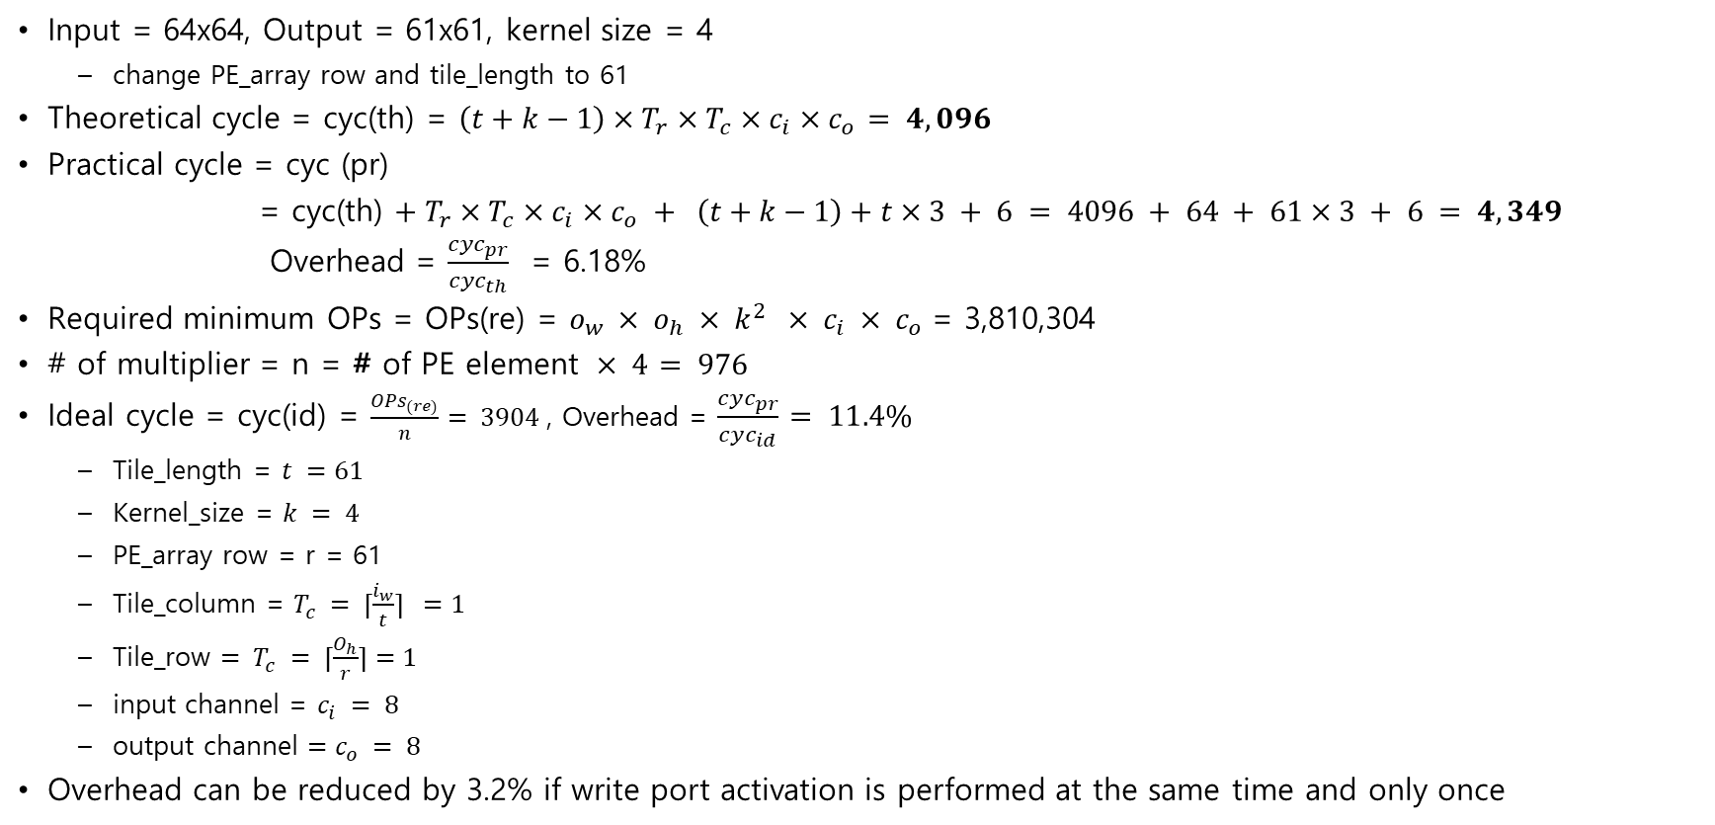
Optimize Configuration
Input = 64x64, Output = 61x61, kernel size = 4
  change PE_array row and tile_length to 61
Theoretical cycle = cyc(th) = $\left(t+k−1\right)×T_{r}×T_{c}×c_{i}×c_{o}$ $= 4,096$
Practical cycle = cyc (pr)
= cyc(th) $+ T_{r}×T_{c}×c_{i}×c_{o} + \left(t+k−1\right)+t×3 + 6 = 4096 + 64 + 61×3 + 6 = 4,349$
Overhead = $\frac{cyc_{pr}}{cyc_{th}}$ = 6.18%
Required minimum OPs = OPs(re) = $o_{w} × o_{h} × k^{2} × c_{i} × c_{o}$= 3,810,304
# of multiplier = n = # of PE element $× 4$ $= 976$
Ideal cycle = cyc(id) = $\frac{{OPs}_{(re)}}{n}$ $= 3904$, Overhead = $\frac{cyc_{pr}}{cyc_{id}}$ $= 11.4\%$
  Tile_length = $t =61$
  Kernel_size = $k = 4$
  PE_array row = r = 61
  Tile_column = $T_{c} = ⌈\frac{i_{w}}{t}⌉ =1$
  Tile_row $= T_{c} = ⌈\frac{O_{h}}{r}⌉=1$
  input channel = $c_{i} = 8$
  output channel $=c_{o} = 8$
Overhead can be reduced by 3.2% if write port activation is performed at the same time and only once

Slide 6
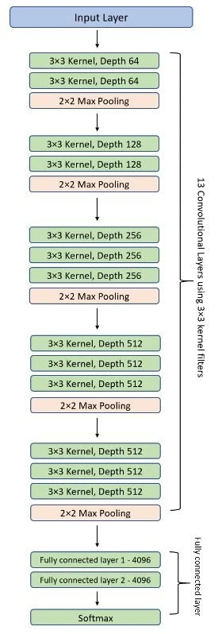
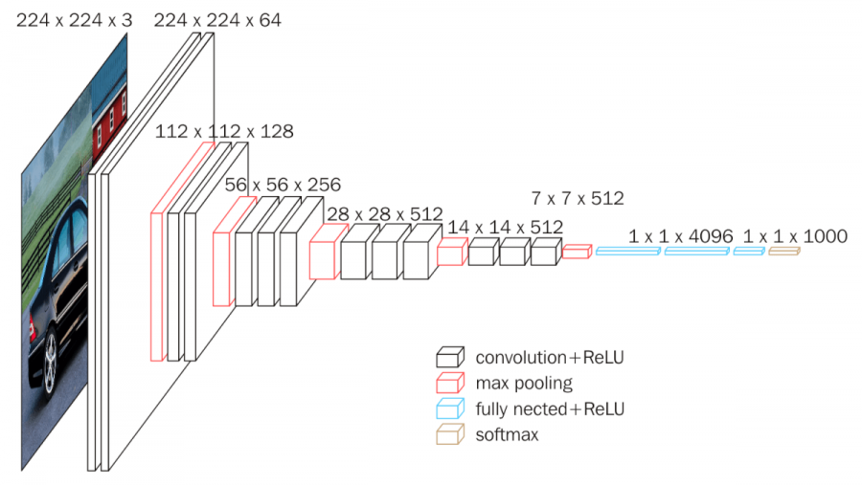
VGG-16 Structure

Slide 7
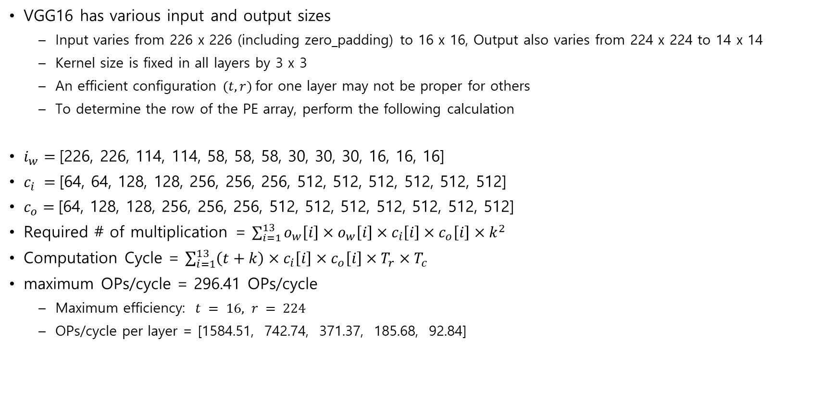
Configuring PE-Arrays for VGG-16
VGG16 has various input and output sizes
  Input varies from 226 x 226 (including zero_padding) to 16 x 16, Output also varies from 224 x 224 to 14 x 14
  Kernel size is fixed in all layers by 3 x 3
  An efficient configuration $(t, r)$for one layer may not be proper for others
  To determine the row of the PE array, perform the following calculation
$i_{w}=$[226, 226, 114, 114, 58, 58, 58, 30, 30, 30, 16, 16, 16]
$c_{i} =$[64, 64, 128, 128, 256, 256, 256, 512, 512, 512, 512, 512, 512]
$c_{o}=$[64, 128, 128, 256, 256, 256, 512, 512, 512, 512, 512, 512, 512]
Required # of multiplication = $\sum_{i=1}^{13}{o_{w}\left[i\right]×o_{w}\left[i\right]×c_{i}\left[i\right]×c_{o}\left[i\right]×k^{2}}$
Computation Cycle = $\sum_{i=1}^{13}{\left(t+k\right)×c_{i}\left[i\right]×c_{o}\left[i\right]×T_{r}×T_{c}}$
maximum OPs/cycle = 296.41 OPs/cycle
  Maximum efficiency: $t = 16, r = 224$
  OPs/cycle per layer = [1584.51, 742.74, 371.37, 185.68, 92.84]

Slide 8
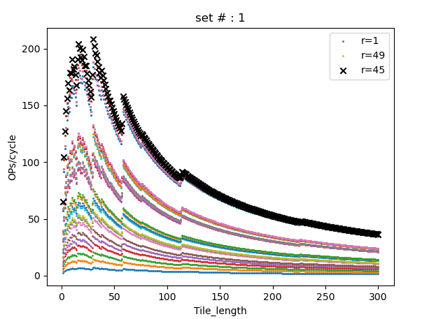
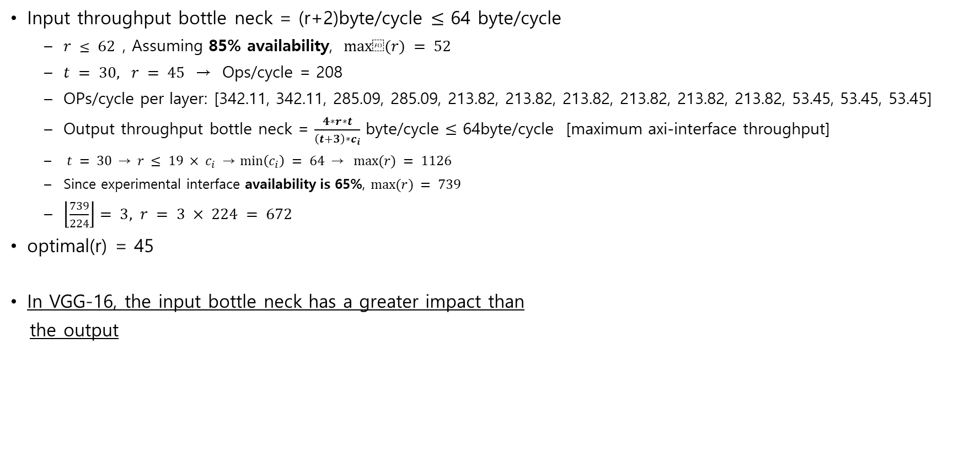
Configuring PE-ROW for Memory Bottleneck
Input throughput bottle neck = (r+2)byte/cycle $≤$ 64 byte/cycle
  $r ≤ 62$, Assuming 85% availability, $max⁡(r) = 52$
  $t = 30, r = 45$ → Ops/cycle = 208
  OPs/cycle per layer: [342.11, 342.11, 285.09, 285.09, 213.82, 213.82, 213.82, 213.82, 213.82, 213.82, 53.45, 53.45, 53.45]
  Output throughput bottle neck = $\frac{4∗r∗t}{\left(t+3\right)∗c_{i}}$ byte/cycle $≤$ 64byte/cycle [maximum axi-interface throughput]
  $t = 30 \text{→} r ≤ 19 × c_{i} \text{→} \min\left(c_{i}\right) = 64 \text{→} max⁡(r) = 1126$
  Since experimental interface availability is 65%, $max⁡(r) = 739$
  $\left\lfloor \frac{739}{224}\right\rfloor$ $= 3, r = 3 × 224 = 672$
optimal(r) = 45
In VGG-16, the input bottle neck has a greater impact than
the output

Slide 9
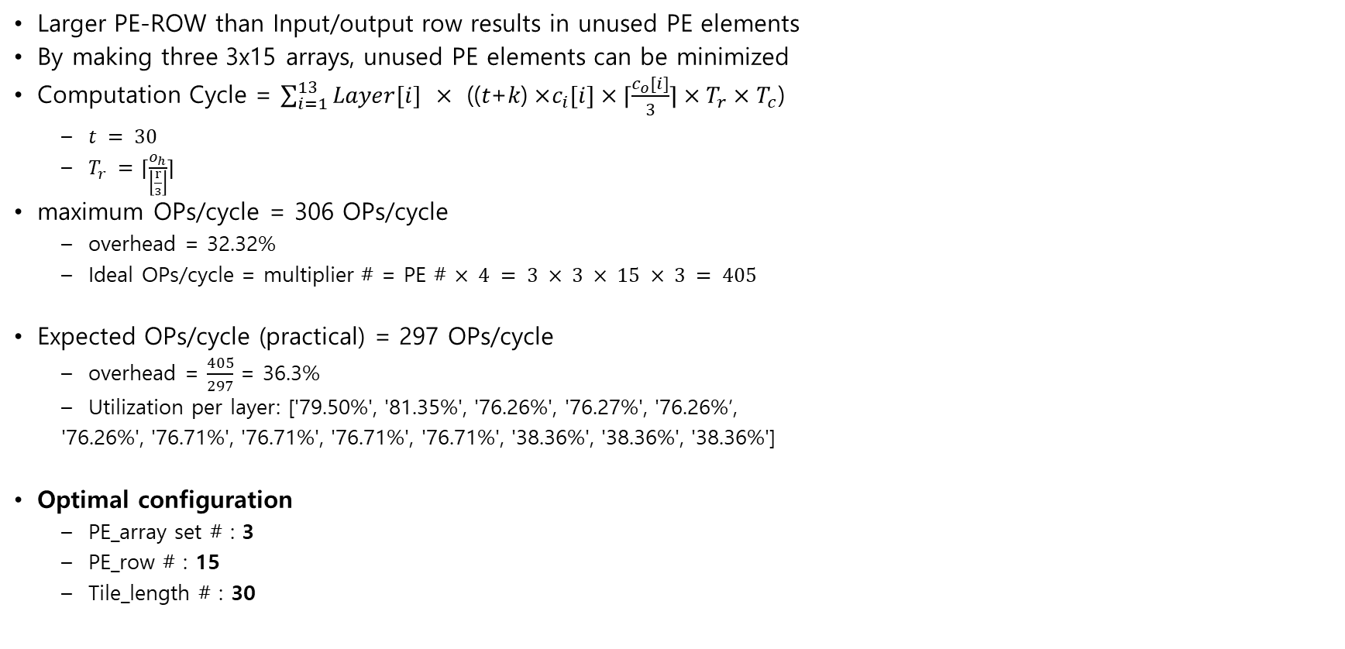
Utilization Unused PE Element
Larger PE-ROW than Input/output row results in unused PE elements
By making three 3x15 arrays, unused PE elements can be minimized
Computation Cycle = $\sum_{i=1}^{13}{Layer[i] ×\text{ ((}t\text{+}k\text{)} \text{×}c_{i}[i]×⌈\frac{c_{o}[i]}{3}⌉×T_{r}×T_{c}\text{)} }$
  $t = 30$
  $T_{r} =$ $⌈\frac{o_{h}}{\left\lfloor \frac{r}{3}\right\rfloor }⌉$
maximum OPs/cycle = 306 OPs/cycle
  overhead = 32.32%
  Ideal OPs/cycle = multiplier # = PE # $× 4 = 3 × 3 × 15 × 3 = 405$
Expected OPs/cycle (practical) = 297 OPs/cycle
  overhead = $\frac{405}{297}$ = 36.3%
  Utilization per layer: ['79.50%', '81.35%', '76.26%', '76.27%', '76.26%’,
  '76.26%', '76.71%', '76.71%', '76.71%', '76.71%', '38.36%', '38.36%', '38.36%']
Optimal configuration
  PE_array set # : 3
  PE_row # : 15
  Tile_length # : 30

Slide 10
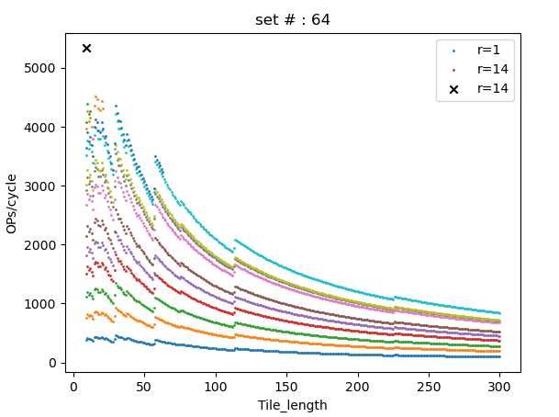
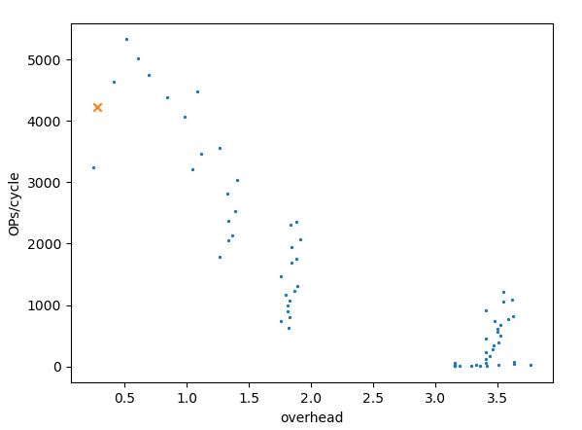
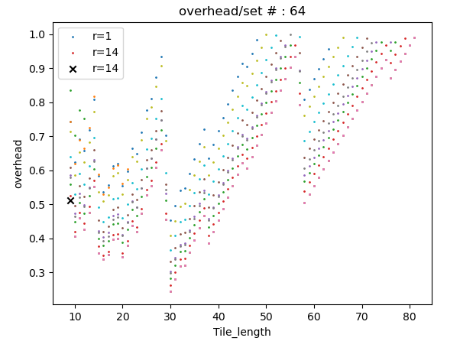
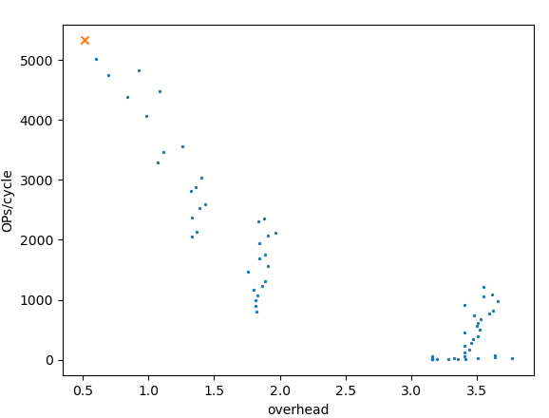

Optimal Configuration
Weight throughput bottle neck = $\frac{s∗k∗k}{\left(t+k\right)}$ $≤$ 64byte/cycle
  s : # of set
  Assuming 85% availability, s $≤$ $6 × (t+k)$
Computation Cycle =$\sum_{i=1}^{13}{Layer[i] ×\text{ ((}t\text{+}k\text{)} \text{×}c_{i}[i]×⌈\frac{c_{o}[i]}{s}⌉×T_{r}×T_{c}\text{)} }$
Fastest configuration
  Ti : 9
  PE_row # : 14
  PE_set # : 64
  OPs/cycle = 5334
  overhead = 51.17%
  Utilization : 66.15%
  Memory utilization : ['31.25%', '93.75%', '100.96%']
Optimal configuration (OPs/cycle/overhead)
  Ti : 30
  PE_row # : 14
  PE_set # : 43
  OPs/cycle = 4228
  overhead = 28.14%
  Utilization : 78.04%
  Memory utilization : ['31.25%', '22.90%', '82.22%']
Optimal configuration2 (OPs/cycle/($utilization^{−1}$))
  Ti : 9
  PE_row # : 14
  PE_set # : 64
Optimal configuration1
Optimal configuration2

Slide 11
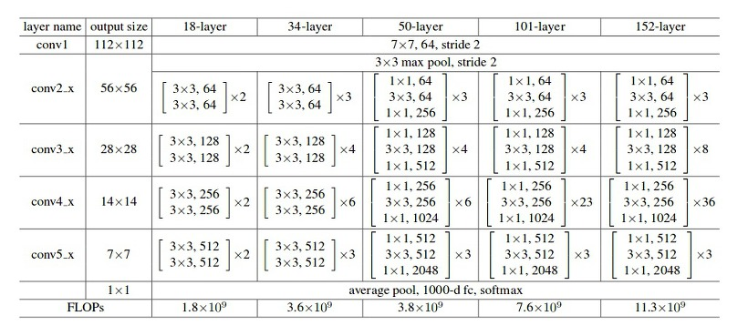

Testing for Other Network (Resnet-50)
Assume that an accelerator is applied to 3x3 convolution on Resnet50
Layer = [3, 4, 6, 3] $i_{w}$ = [58, 30, 16, 9] $c$ = [64, 128, 256, 512] $(c_{i} = c_{o})$
Compute with configuration customized to VGG-16
Fastest configuration
    OPs/cycle : 3953
    overhead : 103.98%
  Optimal configuration
    OPs/cycle : 1643
    overhead : 229.56%

Slide 12
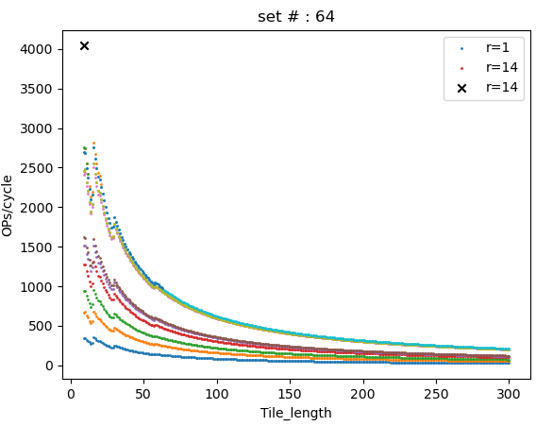
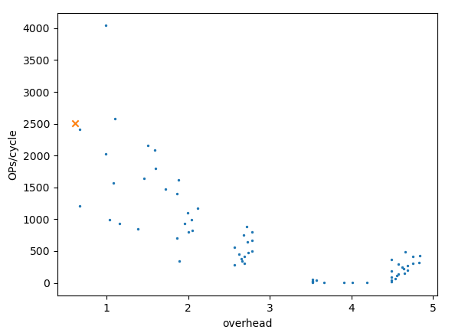
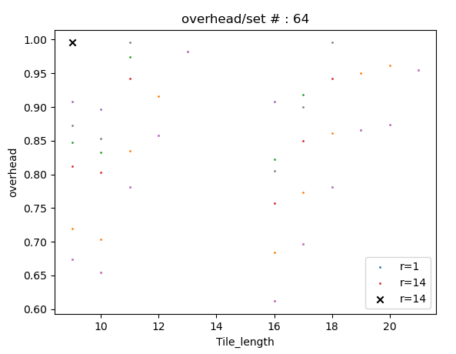
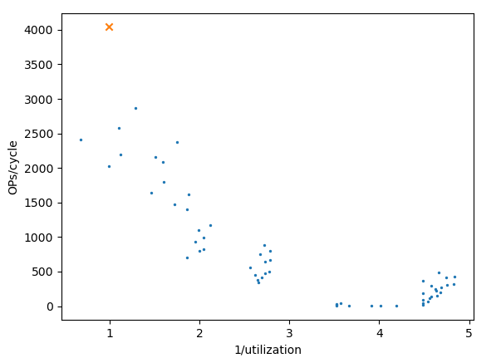
Testing for Other Network (Resnet-50)
Re-configuration to Resnet50
Fastest configuration
    Ti = 9, PE_row = 14, PE_set = 64
    OPs/cycle : 4041
    overhead : 99.55%
    utilization : 50.11%
    Memory utilization : ['31.25%', '93.75%', '100.96%’]
  Optimal configuration1
    Ti = 16, PE_row = 7, PE_set = 64
    OPs/cycle : 2501
    overhead : 61.1%
    utilization : 62.05%
    Memory utilization : ['17.58%', '59.21%', '56.68%']
  Optimal configuration2
    Ti = 9, PE_row = 14, PE_set = 64
Optimal configuration1
Optimal configuration2

Slide 13
Retest VGG16 Using ResNet50 Configuration
Reapply the configuration customized to Resnet50 to VGG-16
Fastest configuration
    Ti = 9, PE_row = 14, PE_set = 64
    OPs/cycle : 4923
    overhead : 63.78%
    Utilization : 61.06%
  configuration2
    Ti = 16, PE_row = 7, PE_set = 64
    OPs/cycle : 2861
    overhead : 40.92%
    Utilization : 70.96%

Slide 14
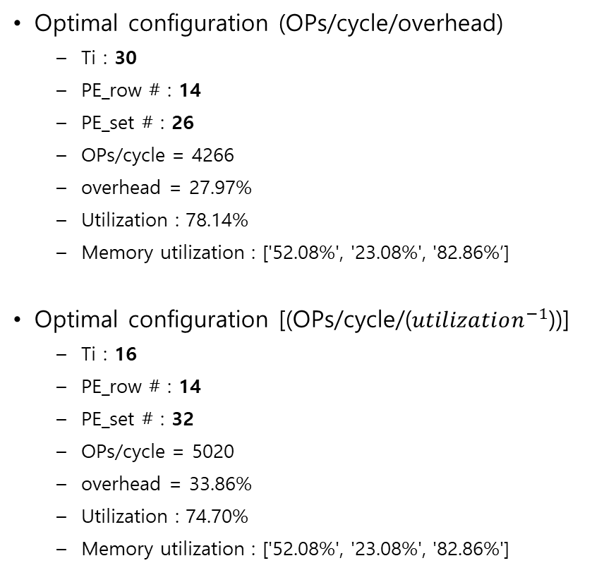
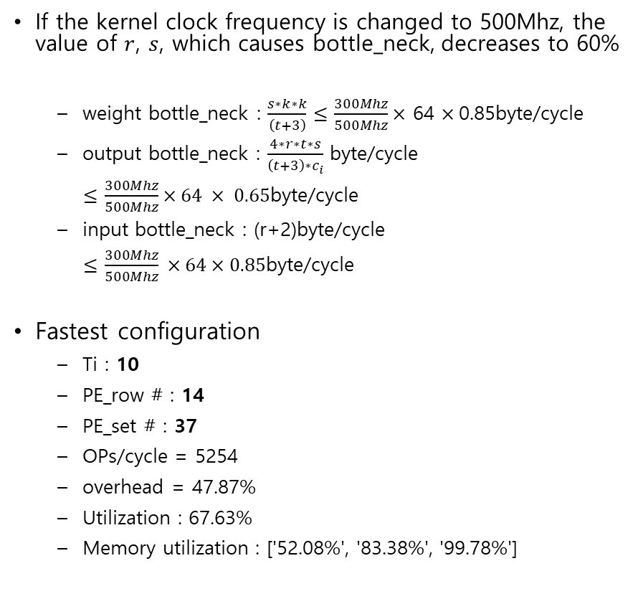
Change Kernel Clock Frequency
If the kernel clock frequency is changed to 500Mhz, the value of $r$, $s$, which causes bottle_neck, decreases to 60%
  weight bottle_neck : $\frac{s∗k∗k}{\left(t+3\right)}$ $≤$ $\frac{300Mhz}{500Mhz}×$ 64 $×$0.85byte/cycle
  output bottle_neck : $\frac{4∗r∗t∗s}{\left(t+3\right)∗c_{i}}$ byte/cycle
  $≤$ $\frac{300Mhz}{500Mhz}×64 × 0.65$byte/cycle
  input bottle_neck : (r+2)byte/cycle
  $\frac{300Mhz}{500Mhz} ×64×0.85$byte/cycle
Fastest configuration
  Ti : 10
  PE_row # : 14
  PE_set # : 37
  OPs/cycle = 5254
  overhead = 47.87%
  Utilization : 67.63%
  Memory utilization : ['52.08%', '83.38%', '99.78%']
Optimal configuration (OPs/cycle/overhead)
  Ti : 30
  PE_row # : 14
  PE_set # : 26
  OPs/cycle = 4266
  overhead = 27.97%
  Utilization : 78.14%
  Memory utilization : ['52.08%', '23.08%', '82.86%’]
Optimal configuration [(OPs/cycle/($utilization^{−1}$))]
  Ti : 16
  PE_row # : 14
  PE_set # : 32
  OPs/cycle = 5020
  overhead = 33.86%
  Utilization : 74.70%
  Memory utilization : ['52.08%', '23.08%', '82.86%']

Slide 15
Configuration table
Design space when the availability is read = 85%, write = 65%
  It is assumed that input and weight read parallelly in different banks
Clock | 300Mhz
Configuration [t, r, s] | [9, 14, 64] |  | [30, 14, 43] |  | [16, 7, 64]
Target model | VGG16 | Resnet50 | VGG16 | Resnet50 | VGG16 | Resnet50 | VGG16 | Resnet50 | VGG16 | Resnet50 | VGG16 | Resnet50
OPs/cycle | 5334 | 4041 | 4228 | 1658 | 3012 | 2501
overhead | 51.17% | 99.55% | 28.14% | 226.64% | 33.86% | 61.16%
PE_utilzation | 66.15% | 50.11% | 78.14% | 30.61% | 74.70% | 62.05%
Memory_utilization [input, weight, output] | ['31.25%', '93.75%', '100.96%'] |  | ['31.25%', '22.90%', '82.22%'] |  | ['17.58%', '59.21%', '56.68%']
configuration | # of Multiplier | Layer utilization
[9, 14 ,64] | 2688 | VGG16 | ['71.79%', '71.79%', '71.79%', '71.79%', '66.67%', '66.67%', '66.67%', '58.33%', '58.33%', '58.33%', '58.33%', '58.33%', '58.33%']
 |  | Resnet50 | ['66.67%', '58.33%', '58.33%', '29.17%']
[30, 14, 43] | 1806 | VGG16 | ['63.14%', '84.19%', '84.19%', '84.19%', '84.19%', '84.19%', '84.19%', '84.19%', '84.19%', '84.19%', '42.10%', '42.10%', '42.10%']
 |  | Resnet50 | ['63.14%', '84.19%', '42.10%', '10.52%']
[16, 7, 64] | 1344 | VGG16 | ['78.60%', '78.60%', '73.68%', '73.68%', '73.68%', '73.68%', '73.68%', '73.68%', '73.68%', '73.68%', '73.68%', '73.68%', '73.68%']
 |  | Resnet50 | ['73.68%', '73.68%', '73.68%', '36.84%']
 |  | VGG16
 |  | Resnet50

Slide 16
Configuration table
Design space when the availability is read = 85%, write = 65%
  It is assumed that input and weight read parallelly in different banks
Clock | 500Mhz
Configuration [t, r, s] | [10, 14, 37] |  | [30, 14, 26] |  | [16, 14, 32] |  | [16, 7, 64]
Target model | VGG16 | Resnet50 | VGG16 | Resnet50 | VGG16 | Resnet50 | VGG16 | Resnet50 | VGG16 | Resnet50 | VGG16 | Resnet50
OPs/cycle | 5254 | 3675 | 4266 | 1673 | 5020 | 3169 | 5020 | 4169
overhead | 47.87% | 111.38% | 27.97% | 226.18% | 33.86% | 112.05% | 33.86% | 61.16%
PE_utilzation | 67.63% | 47.31% | 78.14% | 30.66% | 74.70% | 47.16% | 74.70% | 62.05%
Memory_utilization [input, weight, output] | ['52.08%', '83.38%', '99.78%'] |  | ['52.08%', '23.08%', '82.86%'] |  | ['52.08%', '49.34%', '94.47%'] |  | ['29.30%', '98.68%', '94.47%']
configuration | # of Multiplier | Layer utilization
[10, 14, 37] | 1554 | VGG16 | ['64.79%', '64.79%', '62.09%', '70.96%', '70.96%', '70.96%', '70.96%', '70.96%', '70.96%', '70.96%', '53.22%', '53.22%', '53.22%']
 |  | Resnet50 | ['62.09%', '62.09%', '53.22%', '26.61%']
[30, 14, 26] | 1092 | VGG16 | ['69.62%', '83.54%', '83.54%', '83.54%', '83.54%', '83.54%', '83.54%', '83.54%', '83.54%', '83.54%', '41.77%', '41.77%', '41.77%']
 |  | Resnet50 | ['69.62%', '83.54%', '41.77%', '10.44%']
[16, 14, 32] | 1344 | VGG16 | ['78.60%', '78.60%', '73.68%', '73.68%', '73.68%', '73.68%', '73.68%', '73.68%', '73.68%', '73.68%', '73.68%', '73.68%', '73.68%']
 |  | Resnet50 | ['73.68%', '73.68%', '73.68%', '18.42%']
[16, 7, 64] | 1344 | VGG16 | ['78.60%', '78.60%', '73.68%', '73.68%', '73.68%', '73.68%', '73.68%', '73.68%', '73.68%', '73.68%', '73.68%', '73.68%', '73.68%']
 |  | Resnet50 | ['73.68%', '73.68%', '73.68%', '36.84%']

Slide 17
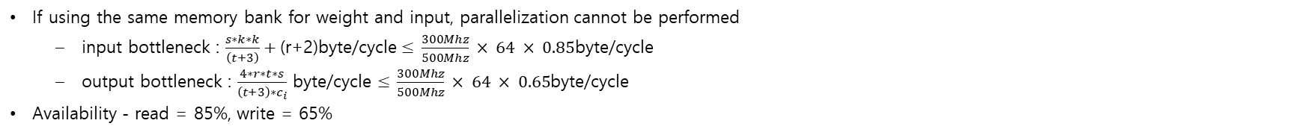
Configuration Table Using Same Memory Bank
If using the same memory bank for weight and input, parallelization cannot be performed
  input bottleneck : $\frac{s∗k∗k}{\left(t+3\right)}+\text{(}\text{r}\text{+2)}\text{byte}\text{/}\text{cycle}≤$ $\frac{300Mhz}{500Mhz} × 64 × 0.85$byte/cycle
  output bottleneck : $\frac{4∗r∗t∗s}{\left(t+3\right)∗c_{i}}$ byte/cycle $≤$ $\frac{300Mhz}{500Mhz} × 64 × 0.65$byte/cycle
Availability - read = 85%, write = 65%
Clock | 300Mhz
Configuration [t, r, s] | [30, 14, 52] |  | [30, 14, 43] |  | [16, 7, 86] |  | [16, 7, 64]
Target model | VGG16 | Resnet50 | VGG16 | Resnet50 | VGG16 | Resnet50 | VGG16 | Resnet50 | VGG16 | Resnet50 | VGG16 | Resnet50
OPs/cycle | 4793 | 1920 | 4228 | 1658 | 3671 | 2970 | 3012 | 2501
overhead | 36.67% | 241.14% | 28.14% | 226.64% | 47.55% | 82.37% | 33.86% | 61.16%
PE_utilzation | 73.17% | 29.31% | 78.04% | 30.61% | 67.77% | 54.83% | 74.70% | 62.05%
Memory_utilization [input, weight, output] | ['31.25%', '27.70%', '99.43%'] |  | ['31.25%', '22.90%', '82.22%'] |  | [17.58%, 79.56%, 76.16%] |  | [17.58%, 59.21%, 56.68%]
configuration | # of PE | Layer utilization
[30, 14, 52] | 2184 | VGG16 | ['52.21%', '69.62%', '69.62%', '83.54%', '83.54%', '83.54%', '83.54%', '83.54%', '83.54%', '83.54%', '41.77%', '41.77%', '41.77%']
 |  | Resnet50 | ['52.21%', '69.62%', '41.77%', '10.44%']
[30, 14, 43] | 1806 | VGG16 | ['63.14%', '84.19%', '84.19%', '84.19%', '84.19%', '84.19%', '84.19%', '84.19%', '84.19%', '84.19%', '42.10%', '42.10%', '42.10%']
 |  | Resnet50 | ['63.14%', '84.19%', '42.10%', '10.52%']
[16, 7, 86] | 1806 | VGG16 | ['58.49%', '58.49%', '54.83%', '73.11%', '73.11%', '73.11%', '73.11%', '73.11%', '73.11%', '73.11%', '73.11%', '73.11%', '73.11%']
 |  | Resnet50 | ['54.83%', '54.83%', '73.11%', '36.56%']
[16, 7, 64] | 1344 | VGG16 | ['78.60%', '78.60%', '73.68%', '73.68%', '73.68%', '73.68%', '73.68%', '73.68%', '73.68%', '73.68%', '73.68%', '73.68%', '73.68%']
 |  | Resnet50 | ['73.68%', '73.68%', '73.68%', '36.84%']

Slide 18
Configuration Table Using Same Memory Bank
If using the same memory bank for weight and input, parallelization cannot be performed
  input bottleneck : $\frac{s∗k∗k}{\left(t+3\right)}+\text{(}\text{r}\text{+2)}\text{byte}\text{/}\text{cycle}≤$ $\frac{300Mhz}{500Mhz} × 64 × 0.85$byte/cycle
  output bottleneck : $\frac{4∗r∗t∗s}{\left(t+3\right)∗c_{i}}$ byte/cycle $≤$ $\frac{300Mhz}{500Mhz} × 64 × 0.65$byte/cycle
Availability - read = 85%, write = 65%
Clock | 500Mhz
Configuration [t, r, s] | [20, 14, 32] |  | [30, 14, 26] |  | [16, 8, 43] |  | [16, 7, 43]
Target model | VGG16 | Resnet50 | VGG16 | Resnet50 | VGG16 | Resnet50 | VGG16 | Resnet50 | VGG16 | Resnet50 | VGG16 | Resnet50
OPs/cycle | 4999 | 2698 | 4266 | 1673 | 3599 | 2708 | 3271 | 2640
overhead | 34.42% | 149.00% | 27.97% | 226.18% | 43.35% | 90.51% | 38.02% | 70.97%
PE_utilzation | 74.40% | 40.16% | 78.14% | 30.66% | 69.76% | 52.49% | 72.45% | 58.49%
Memory_utilization [input, weight, output] | ['52.08%’, '40.76%', '97.55%'] |  | ['52.08%', '23.08%', '82.86%'] |  | ['32.55%', '66.30%', '72.54%'] |  | ['29.30%', '66.30%', '63.47%']
configuration | # of PE | Layer utilization
[20, 14, 32] | 1344 | VGG16 | ['81.16%', '81.16%', '81.16%', '81.16%', '81.16%', '81.16%', '81.16%', '60.87%', '60.87%', '60.87%', '60.87%', '60.87%', '60.87%']
 |  | Resnet50 | ['81.16%', '60.87%', '60.87%', '15.22%']
[30, 14, 26] | 1092 | VGG16 | ['69.62%', '83.54%', '83.54%', '83.54%', '83.54%', '83.54%', '83.54%', '83.54%', '83.54%', '83.54%', '41.77%', '41.77%', '41.77%']
 |  | Resnet50 | ['69.62%', '83.54%', '41.77%', '10.44%']
[16, 8, 43] | 1032 | VGG16 | ['58.49%', '77.99%', '73.11%', '73.11%', '73.11%', '73.11%', '73.11%', '63.97%', '63.97%', '63.97%', '63.97%', '63.97%', '63.97%']
 |  | Resnet50 | ['54.83%', '73.11%', '73.11%', '36.56%']
[16, 7, 43] | 903 | VGG16 | ['58.49%', '77.99%', '73.11%', '73.11%', '73.11%', '73.11%', '73.11%', '73.11%', '73.11%', '73.11%', '73.11%', '73.11%', '73.11%']
 |  | Resnet50 | ['54.83%', '73.11%', '73.11%', '36.56%']

Slide 19
Configuration Table Issue resolved
If the Initial Weight load and Write back Overhead Issue are resolved, the following configuration is possible
  input bottle_neck : $\frac{s∗k∗k}{\left(t\right)}+\text{(}\text{r}\text{+2)}\text{byte}\text{/}\text{cycle}≤$ $\frac{300Mhz}{500Mhz}×64 × 0.85$byte/cycle
  output bottle_neck : $\frac{4∗r∗t∗s}{\left(t\right)∗c_{i}}$ byte/cycle $≤$ $\frac{300Mhz}{500Mhz}×64 × 0.65$byte/cycle
Clock | 300Mhz
Configuration [t, r, s] | [16, 14, 47] |  | [10, 14, 32] |  | [16, 14, 43] |  | [16, 10, 64] |  | [16, 7, 64]
Target model | VGG16 | Resnet50 | VGG16 | Resnet50 | VGG16 | Resnet50 | VGG16 | Resnet50 | VGG16 | Resnet50
OPs/cycle | 4828 | 3010 | 3729 | 2617 | 4661 | 2894 | 4722 | 3272 | 3576 | 2970
overhead | 22.65% | 96.71% | 8.12% | 54.02% | 16.23% | 87.17% | 21.96% | 76.02% | 12.73% | 35.71%
PE_utilzation | 81.53% | 50.84% | 92.49% | 64.93% | 86.04% | 53.43% | 81.99% | 56.81% | 88.71% | 73.68%
Memory_utilization [input, weight, output] | ['31.25%', '51.64%', '98.86%'] |  | ['31.25%', '56.25%', '67.31%'] |  | ['31.25%', '47.24%', '90.44%'] |  | ['23.44%', '70.31%', '96.15%'] |  | ['17.58%', '70.31%', '67.31%']
configuration | # of PE | Layer utilization
[16, 14, 47] | 1974 | VGG16 | ['63.55%', '84.73%', '79.43%', '79.43%', '79.43%', '79.43%', '86.65%', '86.65%', '86.65%', '86.65%', '86.65%', '86.65%', '86.65%']
 |  | Resnet50 | ['59.57%', '79.43%', '79.43%', '21.66%']
[10, 14, 32] | 1344 | VGG16 | ['97.39%', '97.39%', '93.33%', '93.33%', '93.33%', '93.33%', '93.33%', '93.33%', '93.33%', '93.33%', '70.00%', '70.00%', '70.00%']
 |  | Resnet50 | ['93.33%', '93.33%', '70.00%', '35.00%']
[16, 14, 43] | 1806 | VGG16 | ['69.46%', '92.61%', '86.82%', '86.82%', '86.82%', '86.82%', '86.82%', '86.82%', '86.82%', '86.82%', '86.82%', '86.82%', '86.82%']
 |  | Resnet50 | ['65.12%', '86.82%', '86.82%', '21.71%']
[16, 10, 64] | 1920 | VGG16 | ['90.90%', '90.90%', '81.67%', '81.67%', '81.67%', '81.67%', '81.67%', '81.67%', '81.67%', '81.67%', '61.25%', '61.25%', '61.25%']
 |  | Resnet50 | ['81.67%', '81.67%', '61.25%', '30.63%']
[16, 7, 64] | 1344 | VGG16 | ['93.33%', '93.33%', '87.50%', '87.50%', '87.50%', '87.50%', '87.50%', '87.50%', '87.50%', '87.50%', '87.50%', '87.50%', '87.50%']
 |  | Resnet50 | ['87.50%', '87.50%', '87.50%', '43.75%']

Slide 20
Configuration Table Issue resolved
If the Initial Weight load and Write back Overhead Issue are resolved, the following configuration is possible
  input bottle_neck : $\frac{s∗k∗k}{\left(t\right)}+\text{(}\text{r}\text{+2)}\text{byte}\text{/}\text{cycle}≤$ $\frac{300Mhz}{500Mhz}×64 × 0.85$byte/cycle
  output bottle_neck : $\frac{4∗r∗t∗s}{\left(t\right)∗c_{i}}$ byte/cycle $≤$ $\frac{300Mhz}{500Mhz}×64 × 0.65$byte/cycle
Clock | 500Mhz
Configuration [t, r, s] | [30, 14, 27] |  | [10, 14, 16] |  | [17, 14, 27] |  | [16, 7, 32] |  | [16, 7, 37]
Target model | VGG16 | Resnet50 | VGG16 | Resnet50 | VGG16 | Resnet50 | VGG16 | Resnet50 | VGG16 | Resnet50 | VGG16 | Resnet50
OPs/cycle | 4799 | 1893 | 3107 | 2181 | 4723 | 2833 | 2980 | 2475 | 3274 | 2688
overhead | 18.14% | 199.46% | 8.12% | 54.02% | 20.04% | 100.11% | 12.73% | 35.71% | 18.63% | 44.53%
PE_utilzation | 84.65% | 33.39% | 92.49% | 64.93% | 83.31% | 49.97% | 88.71% | 73.68% | 84.30% | 69.19%
Memory_utilization [input, weight, output] | ['52.08%', '26.37%', '94.65%'] |  | ['52.08%', '46.88%', '56.09%'] |  | ['52.08%', '46.53%', '94.65%'] |  | ['29.30%', '58.59%', '56.09%'] |  | ['29.30%', '67.75%', '64.85%']
configuration | # of PE | Layer utilization
[30, 14, 27] | 1134 | VGG16 | ['73.74%', '88.49%', '88.49%', '88.49%', '88.49%', '88.49%', '93.15%', '93.15%', '93.15%', '93.15%', '46.58%', '46.58%', '46.58%']
 |  | Resnet50 | ['73.74%', '88.49%', '44.25%', '11.64%']
[10, 14, 16] | 672 | VGG16 | ['97.39%', '97.39%', '93.33%', '93.33%', '93.33%', '93.33%', '93.33%', '93.33%', '93.33%', '93.33%', '70.00%', '70.00%', '70.00%']
 |  | Resnet50 | ['93.33%', '93.33%', '70.00%', '35.00%']
[17, 14, 27] | 1134 | VGG16 | ['74.36%', '89.24%', '89.24%', '89.24%', '78.08%', '78.08%', '82.19%', '82.19%', '82.19%', '82.19%', '82.19%', '82.19%', '82.19%']
 |  | Resnet50 | ['65.07%', '78.08%', '78.08%', '20.55%']
[16, 7, 32] | 672 | VGG16 | ['93.33%', '93.33%', '87.50%', '87.50%', '87.50%', '87.50%', '87.50%', '87.50%', '87.50%', '87.50%', '87.50%', '87.50%', '87.50%']
 |  | Resnet50 | ['87.50%', '87.50%', '87.50%', '43.75%']
[16, 7, 37] | 777 | VGG16 | ['80.72%', '80.72%', '75.68%', '86.49%', '86.49%', '86.49%', '86.49%', '86.49%', '86.49%', '86.49%', '86.49%', '86.49%', '86.49%']
 |  | Resnet50 | ['75.68%', '75.68%', '86.49%', '43.24%']

